Slide 1
IT694 Computer Networks
Week14_Lec2

Slide 2
There are 2 switches in the Testking LAN, with no routers. Ports 1, 2 & 3 are
assigned to VLAN 1 in switch 1 and 2 and ports 4, 5 & 6 are assigned to VLAN 2 in
both switches. These two switches are connected together via a trunked link. Which
of the conditions below would verify trunk and VLAN operation? (Select all valid
answers)
A. Host 1 on VLAN 1 can ping Host 2 on VLAN 1
B. Host 1 on VLAN 1 can ping Host 4 on VLAN 2
C. Host 1 on VLAN 1 can not ping Host 2 on VLAN 1
D. Host 4 on VLAN 2 can not ping Host 1 on VLAN 1
E. Host 4 on VLAN 2 can ping Host 2 on VLAN 2
Answer: A, D,E

Slide 3
You are working as a network technician at TestKing University, when you get a call from the Engineering Faculty. They're complaining that they're receiving
obsolete information from the Business Faculty's network traffic broadcasts.
What can you do to contain the Business Faculty's broadcast while still keeping it
connected to the internet and the enterprise services of the University? (Select all
valid answer choices)
A. Use half and full-duplex Ethernet on the Engineering Department LAN
B. Establish a VTP domain to minimize the obsolete traffic
C. Change the switch IP address of the switch
D. Create separate VLANs and subnets for the two departments and route between the
two
E. Provide greater bandwidth to the Engineering Department LAN
F. Place the business department on a separate subnet and route between networks
Answer: D, F
In order to prevent the broadcast and link level multicast traffic separated between the
departments, they need to be isolated at layer two. This can be accomplished in two ways.
The first is to create separate VLANs and place each department into a different one. The
second method would be to separate the two departments into two completely different
networks, and route between them.

Slide 4
After connecting a PC to an available port on a switch, you find that the PC can not
access any of the resources on the LAN. No other PC's connected to the switch
appear to be having any issues. What is the most likely cause for this problem?
A. The router lacks a routing table entry for the new host
B. The host switch port is assigned to the incorrect VLAN
C. The host MAC address is incorrectly configured
Virtual LANs break up broadcast domains in a layer-two switched internetwork. If a host
is in a different VLAN then the network services it needs to use, the packets must go
through a router. If routing does not take place, the PC will be unable to communicate
with any other devices not in the same VLAN. Answer B is the best answer for this
Answer: A

Slide 5
A technician is investigating a problem with the network shown above. These
symptoms have been observed:
1. All of the user hosts can access the Internet.
2. None of the user hosts can access the server in VLAN9
3. All of the hosts can ping each other.
What could cause the symptoms?
A. Interface S0/0 on the router is down.
B. Interface Fa0/1 on the router is down.
C. Interface Fa0/5 on Testking3 is down.
D. Interface Fa0/4 on Testking3 is down.
E. Testking2 is turned off.
F. Trunking is not enabled on the link between Testking1 and Testking3.
Answer: D
Since all user hosts have access to internet, link to router has to be up. Therefore, router
interface (Fa0/1 - believe it is labeled incorrectly on diagram as Fa1/0) must be up. Since
all hosts can ping each other, but none can get to VLAN 9 which is through single
interface Fa0/4, this interface must be down.

Slide 6
An elementary school has a computer in every classroom. One entire wing of the
school connects to a centrally located hub. The teachers have reported a slowdown
in the past few weeks to the network administrator. The network administrator has
analyzed the network and documented a steep increase in utilization as the teachers
use a new network-based classroom management application. Which solution will
improve the performance the most?
A. Install a router and install another hub in the affected wing.
B. Reboot the router that connects to the hub.
C. Replace the hub with a switch.
D. Ensure all devices in the affected wing have a default gateway.
E. Install a repeater in the affected wing.
Answer: C
By default, switches break up collision domains. In a hub environment, when one particular device sends a packet on a network segment, forcing every other device on that segment to pay attention to it. At the same time, a different device tries to transmit, which leads to a collision, after which both
devices must retransmit, one at a time. Not good-very inefficient!
In contrast, each and every port on a switch represents its own collision domain. In contrast, a hub can't break collision domains or broadcast domains. Similarly hub provides low bandwidth where
switch provides more bandwidth to all ports.
Suppose there are 10 ports with 100 mbps bandwidth then the hub provides only 10 mbps to each port but switch provides 100mbps to all ports aggregated.

Slide 7
Consider the network in Figure 1. All links are Ethernet cables. B1 to B3 are bridges. R1 to R5 are routers.
H1 and H2 are hosts. There is no other network than shown on the figure.
The figure shows the IP and MAC addresses. The MAC addresses are written symbolically as M1 to M22.
All interfaces are configured with network mask 255.255.255.0. All routers run a distance vector routing
protocol.
Since B2 is a bridge, routers R2 and R3 are neighbours for the distance vector routing protocol (and similarly,
R2 and R4 are neighbours, R3 and R4 are neighbours, and R1 and R3 are neighbours.
The link costs are the same in both directions. They are configured as follows.
R1-R3: 10. R1-R2: 1 R2-R3: 1 R2-R4: 1 R3-R4: 1 R3-R5: 10 R4-R5: 1
Thus assume that the costs given above are the costs of the specific networks. For directly connected
networks this then means that e.g. the cost from R5 to 22.22.3/24is 1, the cost from R1 to 22.22.1/24 is 10.

Slide 8
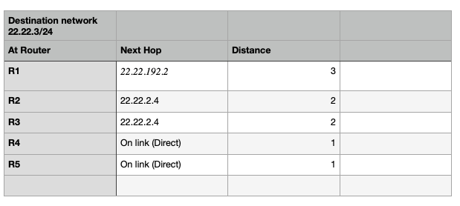
1. Give a possible value of the routing table entry at each router for destination network = 22.22.3/24, assuming the routing protocol has converged. Give the values in the table below (do not give the value of the“interface” field).

Slide 9
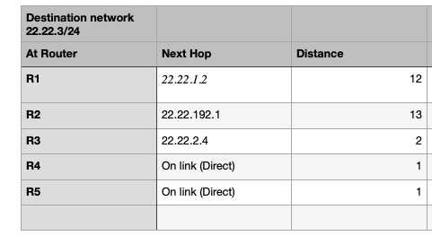
The link between R2 and B2 fails. Explain what happens in all routers, in particular respective to
the destination network 22.22.3/24, by giving a possible sequence of events (max 15 lines). Give the new value of the routing table entry at each router for destination network = 22.22.3/24,
after the routing protocol has converged again. Give the values in the table below (do not give the
value of the“interface” field).
R2, R3, R4 detect failure after timeout
they set the cost of routes to networks, whose next hop is one of the neighbors who timed out, to
infinity. R2 for example had R4 as next hop to reach network 22.22.3/24with a cost of 2, it will
change this to infinity. R3 and R4 will not change anything with respect to 22.22.3/24as their
routes were not affected by the failure. R3 and R4 will however set e.g. costs to 22.22.192/24
to infinity as the next hop was R2.
R2 sends its updated routing information to R1
R1 adopts the entry 22.22.3/24, cost infinity, because it had R2 as next hop of this route.
some time R1 will get an update from R3, saying that 22.22.3/24 is reachable from R3 at a
cost of 2. This plus the cost of the link R1-R3 equals 12 which is smaller than the current cost

